Slide 1


Java ee
(ADVANCE JAVA)
Lecture-53

Slide 2
Today’s Agenda
Introduction To Query String
Using Cookies
Important Methods Of Cookies
Examples

Slide 3
INTRODUCTION TO QUERY STRING
Query strings are another popular mechanism of transmitting the data from one page to the other.
Whenever we use the anchor tag <a> in our page , it generates a clickable link .

Slide 4
INTRODUCTION TO QUERY STRING
For ex: Consider the following anchor tag.
<a href=“home.jsp”>Home Page</a>
Whenever the above tag will run it will generate a link and when the user clicks this link he would be redirected to home.jsp page .
Now during this redirection i.e. while transferring the control to home.jsp if we want to pass some extra information,we can use a technique called Query String.

Slide 5
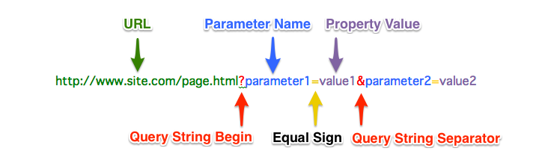
HOW TO CREATE A QUERY STIRNG ?
Query strings are key-value pairs embedded inside href attributes value
Their general syntax is:

Slide 6
HOW TO CREATE A QUERY STIRNG ?
Now whenever the user clicks on the anchor tag these key value pairs are passed as parameters to the target page.
At the server end we can then access it using the the method request.getParameter( ) .

Slide 7
EXERCISE
Write an application that displays 5 items as links to the user titled Mobiles , Books ,Clothes, Deos and Watches. As the user clicks on any of the links a page should open showing the item name user has clicked

Slide 8
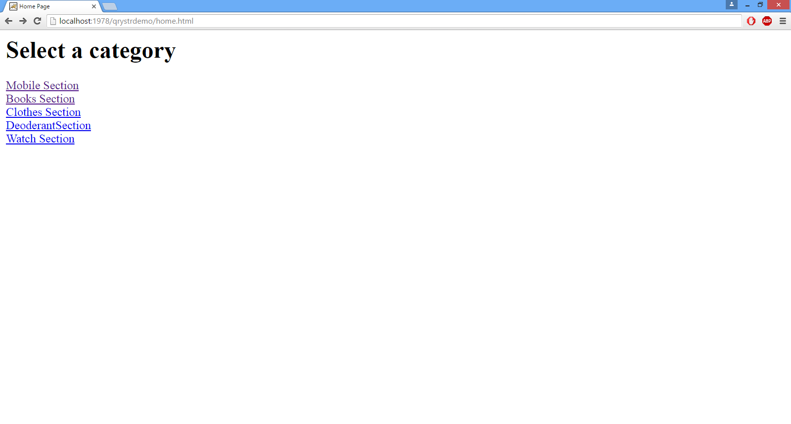
OUTPUT

Slide 9
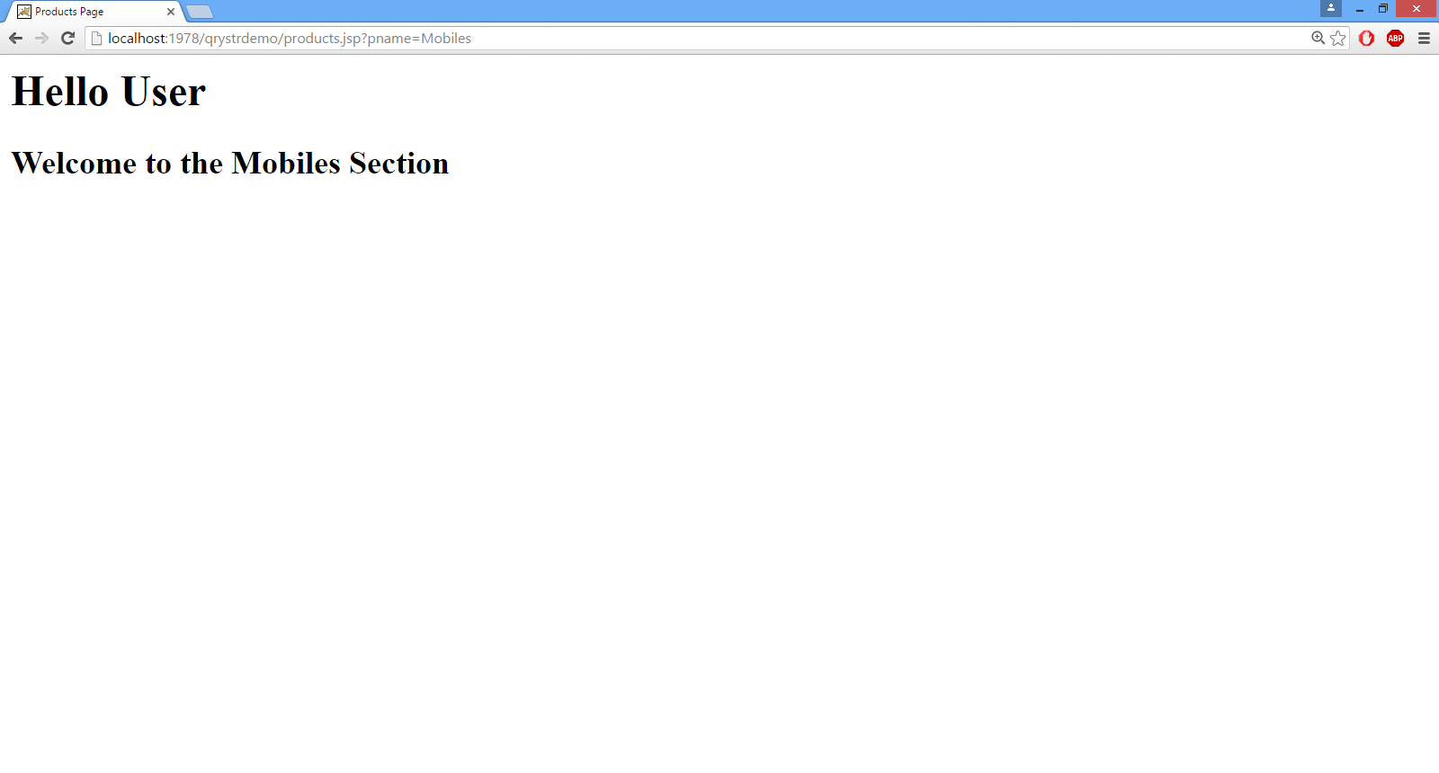
OUTPUT

Slide 10
SOLUTION (home.html)
<html>
<head>
<title>Home Page</title>
</head>
<body>
<h1>Select a category </h1>
<a href="products.jsp?pname=Mobiles">Mobile Section</a><br>
<a href="products.jsp?pname=Books">Books Section</a><br>
<a href="products.jsp?pname=Clothes">Clothes Section</a><br>
<a href="products.jsp?pname=Deos">DeoderantSection</a><br>
<a href="products.jsp?pname=Watches">Watch Section</a>
</body>
</html>

Slide 11
SOLUTION (products.jsp)
<html>
<head>
<title>Products Page</title>
<body>
<%
String prd=request.getParameter("pname");
%>
<h1>Hello User</h1>
<h2>Welcome to the <%= prd %> Section</h2>
</body>
</html>

Slide 12
COOKIES
Cookies are small text files which a browser receives from the server embedded inside the response.
These cookies are then saved by the browser in the secondary memory of the device and next time when the same browser sends next request to the server it also transmits these cookies .
In this way the server can detect whether the request is coming from a new user or revisiting user.

Slide 13
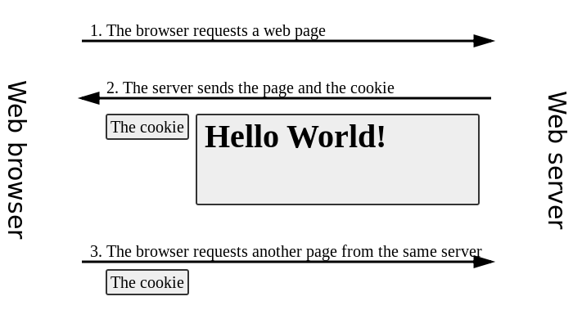
COOKIES

Slide 14
PURPOSE OF COOKIES
Cookies are mainly used for the following purposes .
For recording last login time.
User preferences for ex: sites like youtube use cookies to display a recommended list of videos as per the users previous video views.
An online shopping site can implement things like shopping carts and "quick checkout" options. The cookie contains an ID and lets the site keep track of you as you add different things to your cart. Each item you add to your shopping cart is stored in the site's database along with your ID value. When you check out, the site knows what is in your cart by retrieving all of your selections from the database. It would be impossible to implement a convenient shopping mechanism without cookies or something like them.

Slide 15
RESTRICTIONS OVER COOKIES
However browser themselves have restriction over cookies:
Only 20 cookies will be accepted per site.
Every cookie at the most can have 4kb of data.
Cookies at the most can live upto 3 years in the browser.
Overall browser can have 300 cookies.

Slide 16
HOW JAVA SUPPORTS COOKIES ?
In java , to create and use cookies we have a predefined class called Cookie available in the package javax.servlet.http
This class provides us some very important methods using which we can create cookie , write the data in the cookie, read the data from the cookie etc.

Slide 17
HOW COOKIES ARE SENT TO THE BROWSER ?
To send cookies from server to the browser we have to call a method called addCookie() belonging to HttpServletResponse object.
The prototype of the method is:
public void addCookie(Cookie)

Slide 18
HOW TO RETRIEVE COOKIES SENT BY THE BROWSER ?
To retrieve the cookies which the browser has send we use the method getCookies() belonging to HttpServletRequest object.
The prototype of the method is:
public Cookie[ ] getCookies()

Slide 19
USING THE Cookie CLASS
As mentioned previously , java provides us a class called Cookie for accessing cookie data .
Following is the constructor of this class using which we can create cookie object
Cookie(String name , String value)

Slide 20
METHODS OF Cookie CLASS
public void setValue ( String): This method sets the value of the cookie.
public String getValue( ): This method gets the value of the cookie.
public String getName( ): This method gets the name of the cookie.
public void setMaxAge(int) : This method maintains the life time of cookie in a browser . It accepts an integer as argument representing no. of seconds and makes the cookie live upto that time period in the browser’s memory.

Slide 21
METHODS OF Cookie CLASS
There are 3 possibilities when we call this method :
The time period passed is positive .In this case the cookie will live up to the given no. of seconds at the browser.
The time period pass is negative . In this case the cookie will live only till the browser is closed.
The argument passed is 0 . In this case the cookie will be immediately deleted
5. public int getMaxAge( ) This method returns the
lifetime of Cookie

Slide 22
EXERCISE
Write a web application containing two jsp pages:
page1.jsp: This page should set a cookie containing the current date and time when the user visited the site.
page2.jsp: This page should display the date time set by the previous page.
page1 should also contain the link to go from page1
to page2

Slide 23
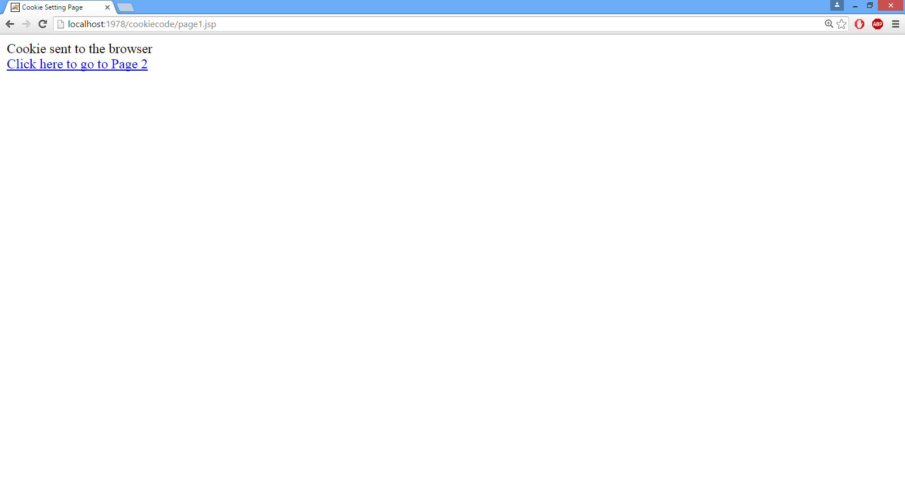
OUTPUT

Slide 24
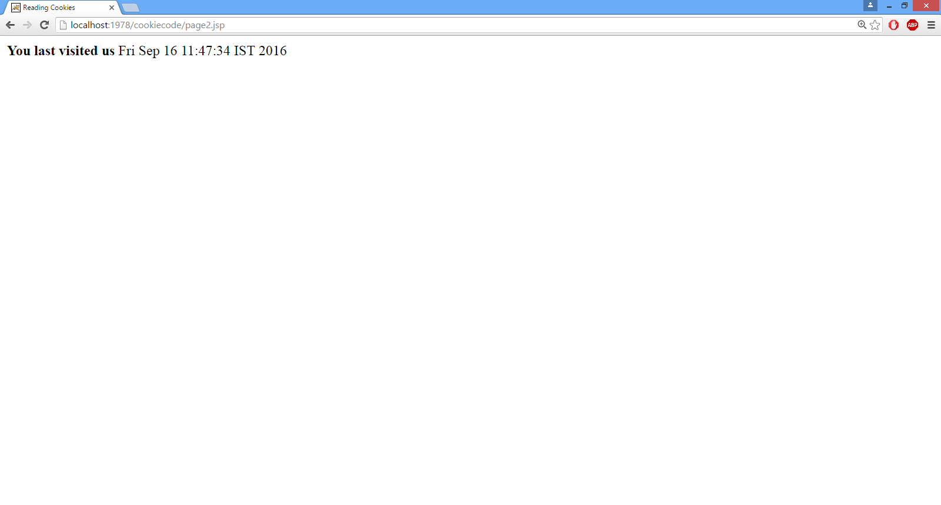
OUTPUT

Slide 25
SOLUTION (page1.jsp)
<html>
<%@ page import="java.util.*" %>
<html>
<head>
<title>Cookie Setting Page</title>
</head>
<body>
<%
Date today=new Date();
Cookie ck=new Cookie("lastvisit",today.toString());
ck.setMaxAge(60*60);
response.addCookie(ck);
out.println("Cookie sent to the browser");
%>
<br><a href="page2.jsp" >Click here to go to Page 2</a>
</body>
</html>

Slide 26
SOLUTION (page2.jsp)
<html>
<head>
<title>Reading Cookies</title>
</head>
<body>
<%
Cookie [] all=request.getCookies();
if(all!=null)
{
for(Cookie c:all)
{
if(c.getName( ).equals("lastvisit"))
{
out.println("<b>You last visited us</b> "+c.getValue());
break;
}
}
}
else
{
out.println("<b>No Cookies present</b>");
}
%>
</body>
</html>

Slide 27
EXERCISE
Write a web application containing a single jsp page. When the page is opened for the first time the page should display the message
“Hello User” and should also record the visit time. Now whenever the page is opened next time it should display “Hello User, Welcome Back” and should display the previous visit’s time

Slide 28
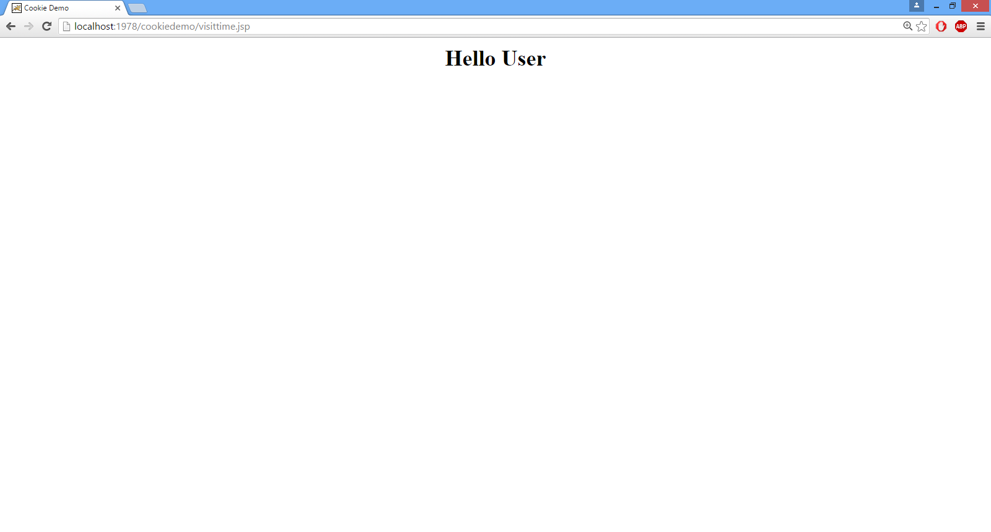
OUTPUT

Slide 29
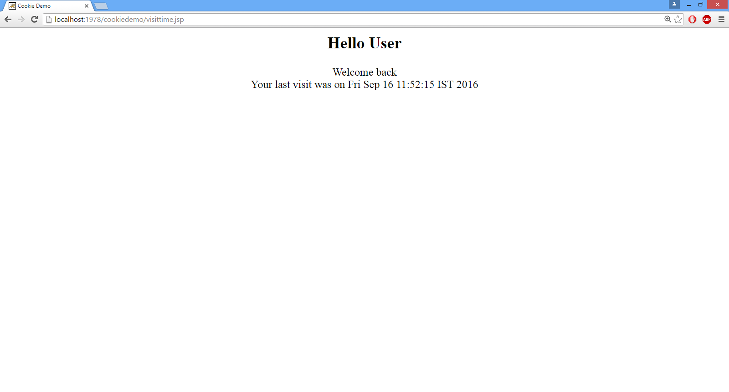
OUTPUT

Slide 30

End Of Lecture
For any queries mail us @: scalive4u@gmail.com
Call us @ : 0755-4271659, 7879165533
Agenda for Next Lecture:
Session Tracking Using Session API
The HttpSession Interface
Working of HttpSession
Methods Of HttpSession

